Slide 1




Estimating Vegetation Productivity for the Conterminous United States using Satellite Observations
Guiatango Saydou Bonsa
Mentor: Dr. Guillermo Ponce
Research lab: Southwest Watershed Research Center

Slide 2
WHY this research
Vegetation productivity is a measurement used to define the state of vegetation over time and across ecosystems
These ecosystems are critical for the future of society, for example :
          grasslands for beef and dairy production
          Agriculture field for supporting crops,
          forest for timber
          THESE ARE JUST A FEW EXAMPLES OF THE IMPORTANCE OF MONITORING VEGETATION PRODUCTIVITY

Slide 3
Why this research
to estimate annual vegetation production over large areas Using Satellite Data
TO facilitate the generation of future data for upcoming years

Slide 4
OBJECTIVES
Produce a dataset of an ESTIMATE for annual vegetation productivity for the conterminous U.S.
Generate a reproducible workflow FOR future YEARS.

Slide 5
METHODOLOGY
Enhanced Vegetation Index (EVI) – Greenness value from Terra-MODIS (MODerate-resolution Imaging Spectroradiometer)
TIMESAT – Time series analysis
R-STUDIO
Greenness value
Ratio of Red, Blue, Near-IR
and coefficients

Slide 6
The Workflow
Google Earth Engine
Data extraction
Image preparation and storage
@ARS-High Performance
Server
(STORM)
Time Series Preparation
R-studio
GDAL
Google Earth Engine
Final Product ingested into GEE
R-Studio
Convert TimeSat outputs into GeoTif images
TimeSat Software
Time Series Analysis

Slide 7
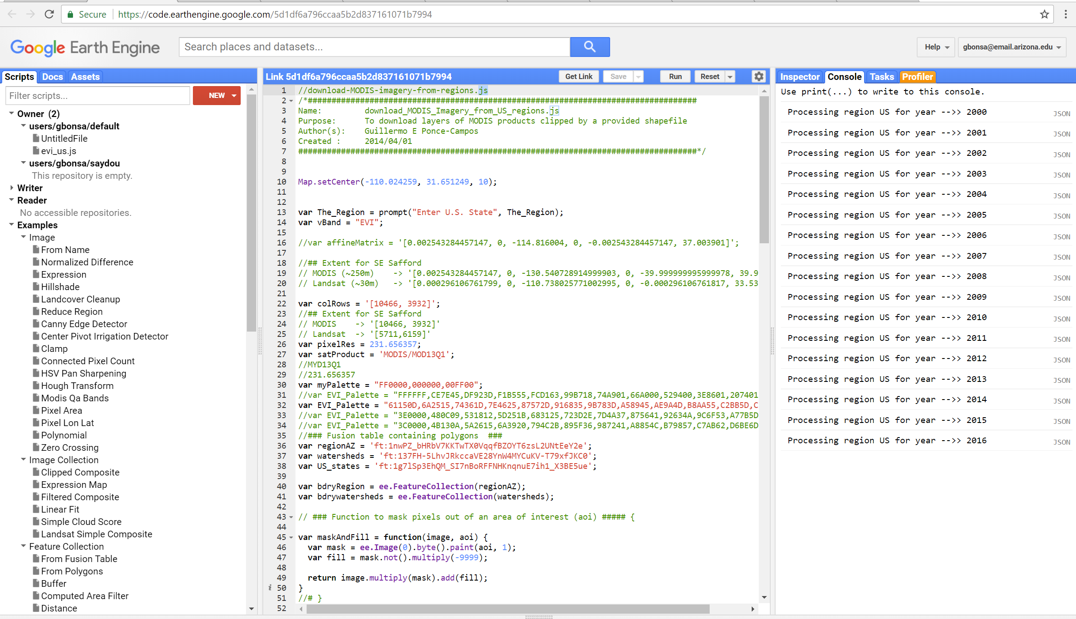
Google EARTH ENGINE
(GEE) and Modis
Google Earth Engine (GEE)
Enhanced Vegetation Index (EVI) – Greenness value from Terra-MODIS (MODerate-resolution Imaging Spectroradiometer)
MODIS (MODerate-resolution Imaging Spectroradiometer)

Slide 8
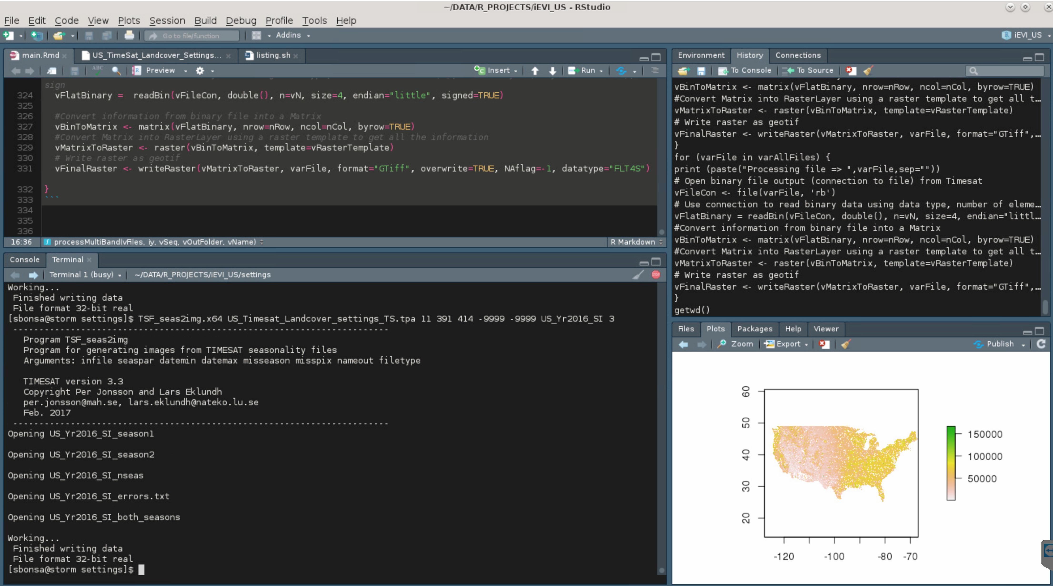
RSTUDIO
Integrated Development Environment
Image processing
Time series preparation
Output images generation

Slide 9
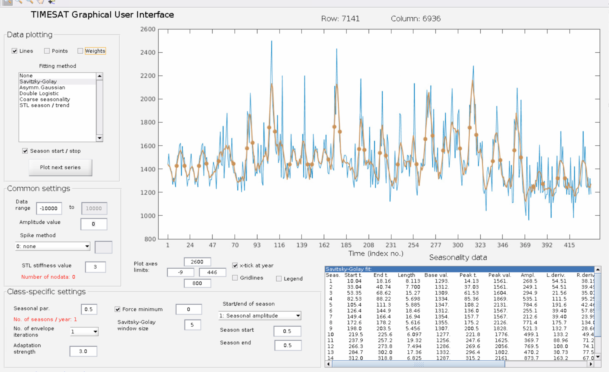
TimeSat
One pixel over time, raw EVI data (blue), smoothed (brown).

Slide 10
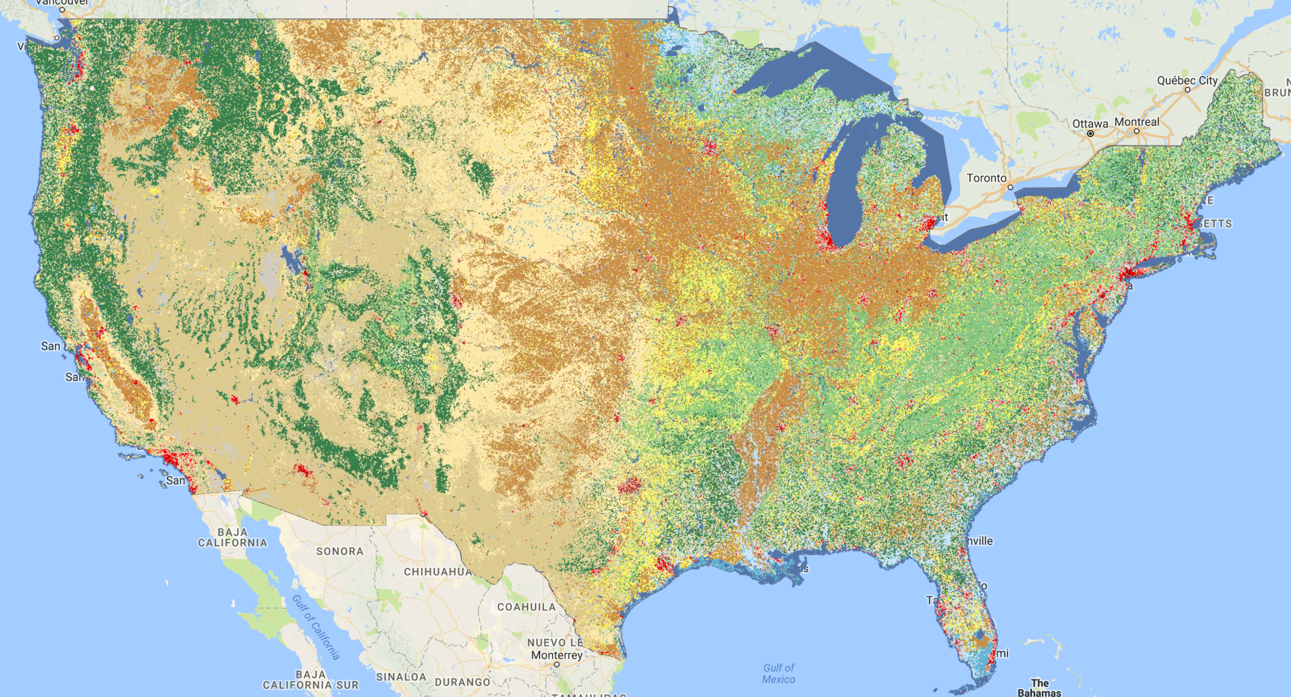
National Landcover Dataset (USGS,2011)
Output values from TimeSat for each pixel
Landcover classes (E.g. Forest, Agriculture, Grasslands, etc.) are used to support TimeSat parameterization. Each class can have its own parameters for time series analysis.
Figure 1. Some of the seasonality parameters generated in TIMESAT: (a) beginning of season, (b) end of season, (c) length of season, (d) base value, (e) time of middle of season, (f) maximum value, (g) amplitude, (h) small integrated value, (h+i) large integrated value. This figure is licensed under a Creative Commons Attribution-NonCommercial-NoDerivs 2.5 Sweden License. It is free to copy and use in other work

Slide 11
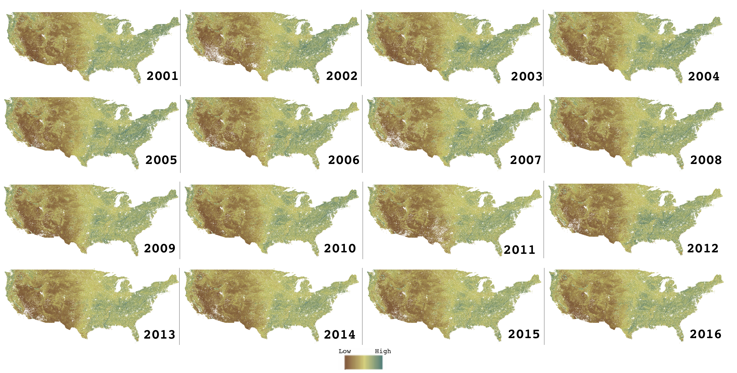
RESULTS: OBJECTIVE 1
Estimated Productivity

Slide 12
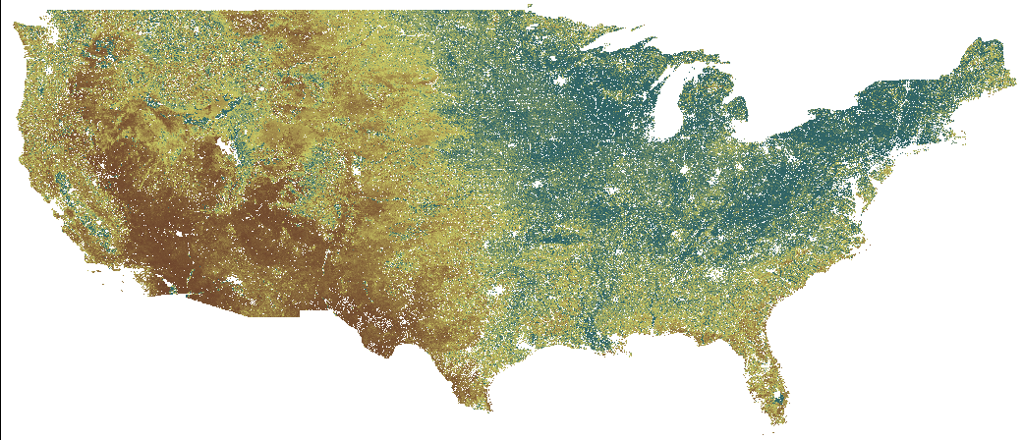
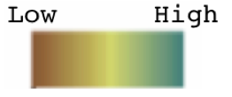
Estimated Productivity
2001

Slide 13
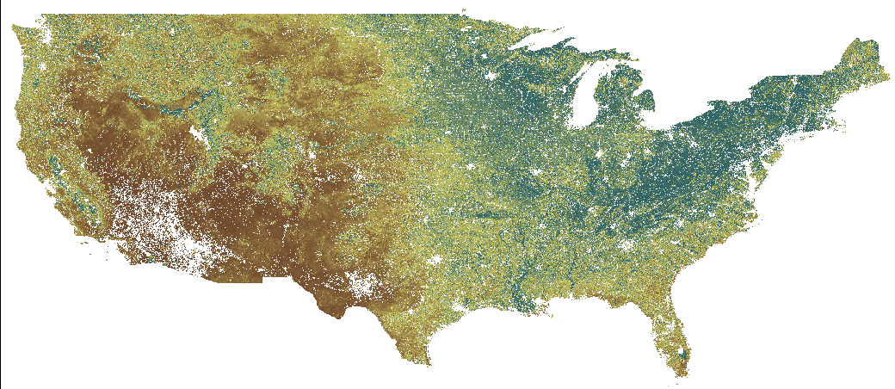
Estimated Productivity
2002

Slide 14
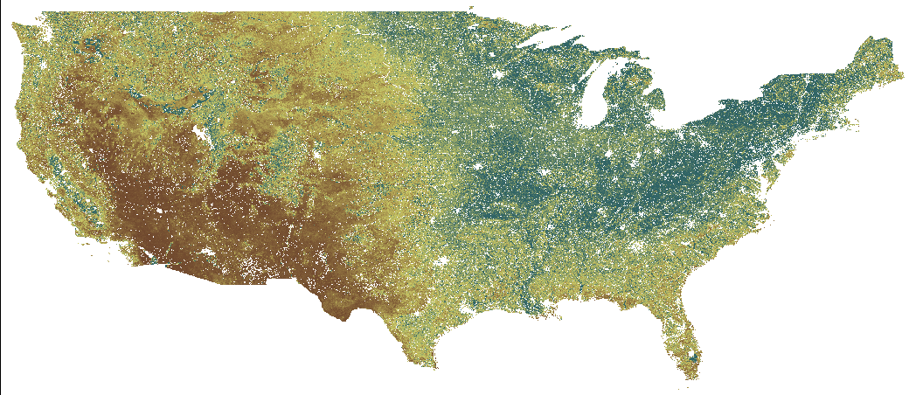
Estimated Productivity
2003

Slide 15
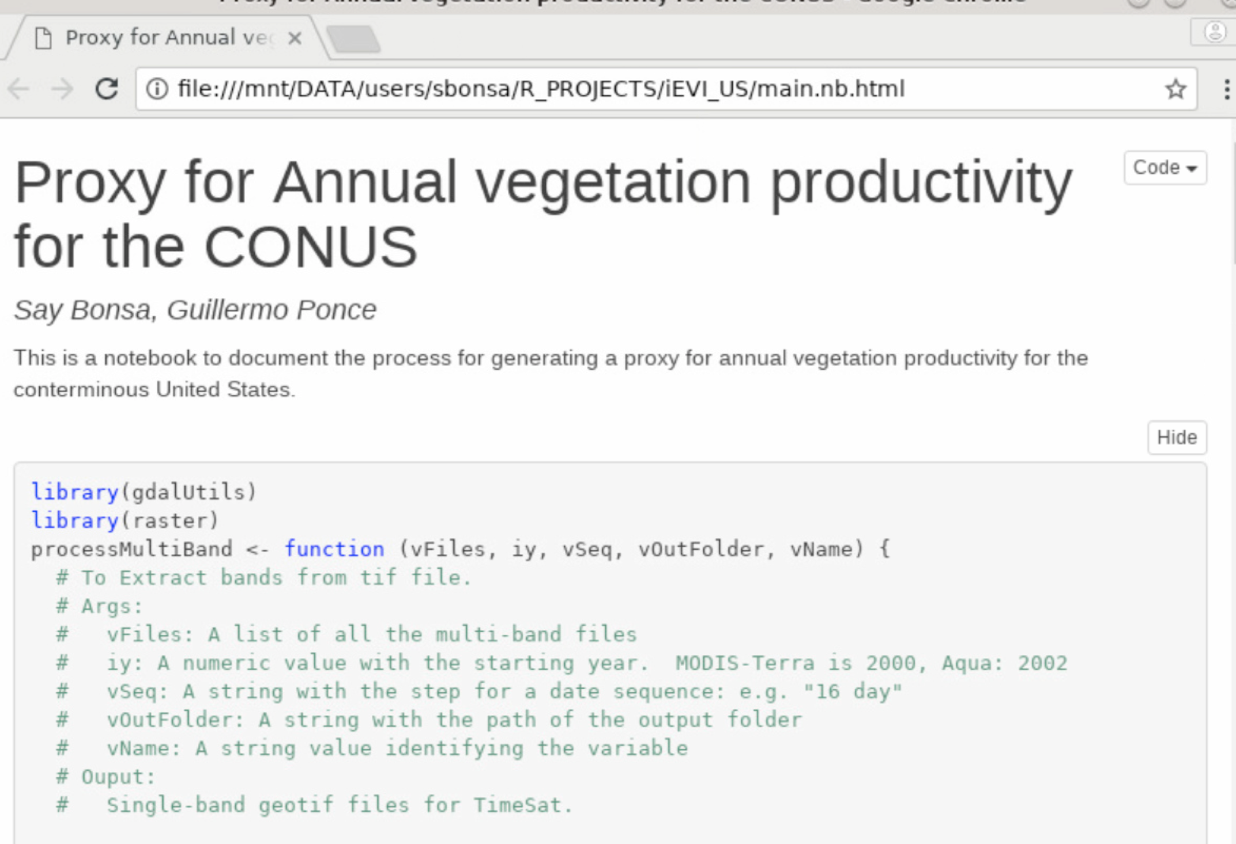
RESULTS: OBJECTIVE 2
Processes were documented as a
R-Notebook for reproducibility

Slide 16
Take Home Message
Dataset will be available in Google Earth Engine
Can be USEFUL FOR scientists interested in vegetation at regional scales
Workflow can be adapted for other time series datasets, (e.g. climate)
Very easy to update for FUTURE USE
Future work will be performed for validation.

Slide 17
ACKNOWLEDGEMENTS
DR. GUILLERMO PONCE
DR. CHANDRA HOLIFIELD COLLINS
USDA-ARS SWRC
ARIZONA SPACE GRANT

Slide 18


Thank you!
IT WAS 46 DEGREES IN TUCSON
18

